Slide 1
Setting up CloudBees Jenkins Operations Center

Slide 2
How do I set up CJOC?
CJOC requires the following:
A VM or server
At least 1 GB for the JVM
One of the following OSs:
Debian
Redhat
Ubuntu
CentOS
Fedora
OpenSuse
Windows
The CJOC WAR or Linux package
Optionally:
A second VM or server for an HA node
A load balancer
NAS accessible from both CJOC nodes

Slide 3
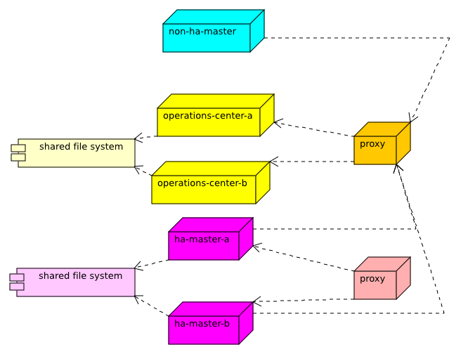
How do I set up CJOC?
General clustered CJOC architecture

Slide 4
Lab Exercise:
Setting up CloudBees Jenkins Operations Center

